Slide 1
A2H [Agri to Home App]
FARMER’S PRODUCE THROUGH ONLINE MARKETING

Slide 2
Problem Statement
A Portal for Farmers to sell their produce at a better rate especially in the pandemic time. System that provides farmers an interface to sell their produce, and connect with the buyers all over India.
Our Theme:
Helping FARMERS “Backbone of India” in the pandemic situation.

Slide 3
Teams approach
A2H APP
The app will be reliable, which will be easy for the farmers to have the interface.
Completely of Voice Controlled
The entire app works on different language interface, for easier recognition
The app will be simple for working in such a way that an illiterate can operate.
It also will be developed by some exotic features that helps the farmers

Slide 4
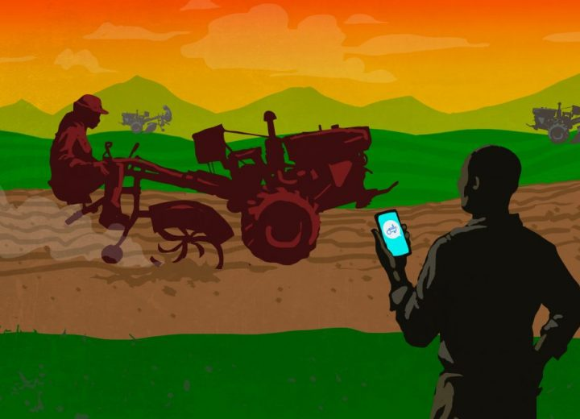
Outlook of the App
Specifications:
1.Native Languages
2.Voice Controlled
3.Easy to Interact
4.Feedback

Slide 5
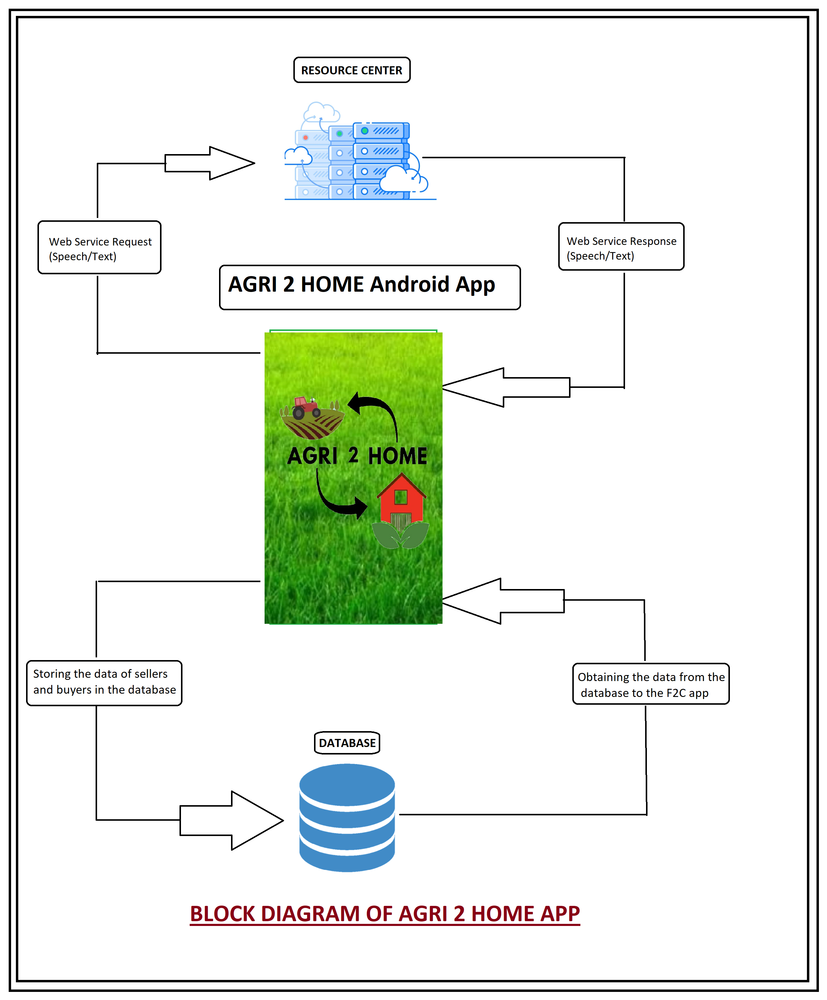
Block Diagram of Android App

